Slide 1
Science and Politics: Telling the Truth About Climate Change
UCSD OSHER Lecture
November 26, 2012
Lewis M. Branscomb
Prof. adjunct IR/PS

Slide 2
Truths and Lies
Truth is mighty and will prevail. There is nothing wrong with this, except that it ain't so.
A lie can travel halfway around the world while the truth is putting on its shoes.
  Mark Twain (1835 – 1910)

Slide 3
Do You Believe Global Warming is NOT a Serious Threat to our Planet?
If so raise your hand.
Do believe the planet is undergoing an unusual level of surface and ocean warming?
Do you think human activities significantly responsible?
Are any of you among those, including some scientists, who are skeptical that burning fossil fuels and cutting forests threaten serious changes in climate?

Slide 4
Outline of this talk
1) Why science is important in public policy.
2) Why Americans trust scientists but not science.
3) What scientists know about climate change.
4) What scientists know how atmospheric CO₂ causes climate change in the oceans.
5) Who is responsible for climate change producers.
6) Climate change skeptics and deniers.
7) First step toward solving the problem of excessive release of CO₂ in the atmosphere: help the public understand their interest in solving it.

Slide 5
Climate and Weather
“Climate is what you expect; Weather is what you get.
Climate is what you affect; Weather is what gets you.”
-- Myles Allen, Professor of Geosystem Science, Oxford University

Slide 6
Why is Science Important in Domestic Public Policy?
Environment
  Climate and severe weather
  Ocean fisheries, sea-level rise
  Air pollution
  Fresh water supplies
Security
  Nuclear proliferation
  Homeland security
  Cyber security
Health and Biology
  Reproductive health
  Infectious disease
  Threat to biological diversity
Economy
  Innovation policies
  Efficient manufacturing
  Nanotechnology
Energy and Resources
  Natural gas “fracking”
  Canadian oil shale
  Wind energy
  Solar power
  Power distribution
  Energy efficiency
  Bio fuels
  Nuclear power safety

Slide 7
Threats from Climate Change
Climate Scientists Predict
  More extreme weather (floods, tornados, hurricanes…)
  Hot, dry droughts in South Western US
  Impacts on agriculture (temp., rain, pollination)
  Increased threats of some vector-borne diseases
  Threats to bio-diversity of plants and animals (which cannot adapt fast enough)
  Sea level rise (threats to coastal habitat and low islands)
  Increased ocean acidity (destruction of reefs and fish)
  Melting of ice caps, threatening Arctic villages
    [see next slide]

Slide 9
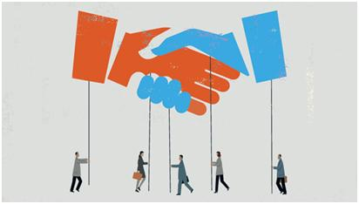
© MARK AIRS/ISTOCKPHOTO.COM
“Scientists are used to debating with one another about [issues seen on]… television and computer screens, which transmit ever-more-heated rhetoric from politicians, pundits, and other public figures [many of whom] …misinterpret, misrepresent, and malign scientific results. This rising tide of spin is the most visible outcome of the growing and troubling disconnect between scientists and much of the rest of society.”
--Lewis Branscomb and Andrew Rosenberg, The Scientist, Oct. 1, 2012
Our society must mitigate the threat of fossil fuel burning in a society that is
not yet convinced of the seriousness of that threat. The industries that create
the fossil fuels will have to be persuaded, legally or through market forces, to
curb their output. This will require overcoming the self-interested climate
deniers, which requires that we first win over the voting public.

Slide 10
How we shall Proceed
Understand the public’s limitations in understanding of complex science issues and voters are slow to direct policy action.
Importance of addressing the climate change problems
One set of data on global warming –
  affect of climate change on oceans
Why many people reject climate change evidence.
What we can do about it.

Slide 11
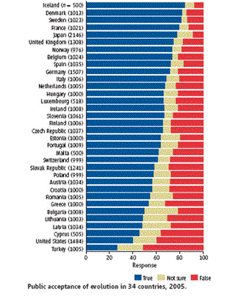
Iceland 1st →
Public Acceptance
of Evolution in 34 Countries in 2005.
Blue: “true”
Yellow: “unsure”
Red: “false”
USA 33rd →
Notes:
USA is 33rd out of 34

Slide 12
Do Americans Accept
Established Science?
39 % do not accept biological evolution
61 % cannot name a fossil fuel
42 % believe people and animals have been this way since the beginning of time.
43 % believe human and dinosaur fossils prove that both lived at the same time.
20 % say the sun circles around the earth.

Slide 13
What Do Americans Believe about Science?
They admire scientists but do not understand how scientists arrive at their conclusions.
When scientists disagree, the public assumes
  neither is right or
  the one whose view best fits their culture, beliefs, and interests is right.
42 % do not think climate change is serious

Slide 14
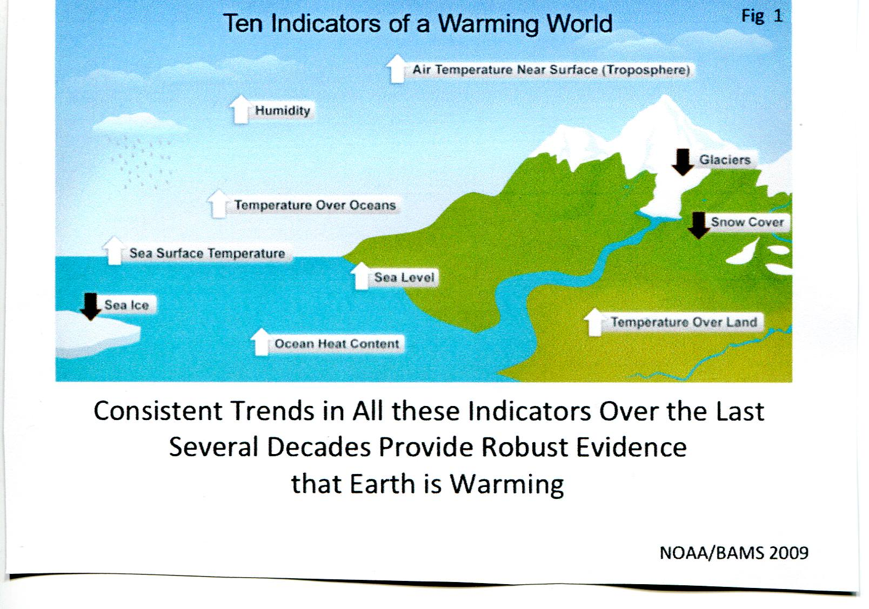
What scientists know about global warming
and its affect on climate?
NOAA/BAMS 2009

Slide 15
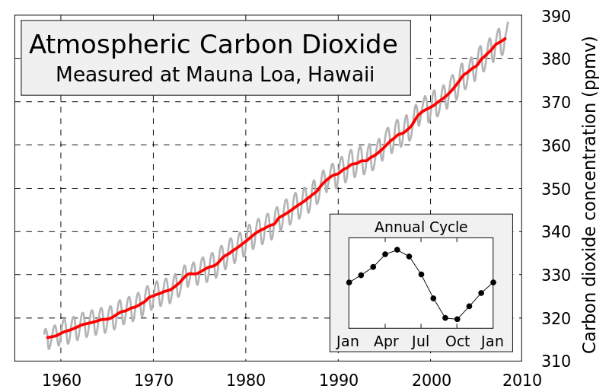
Charles David Keeling Curve
from Wikipedia

Slide 16
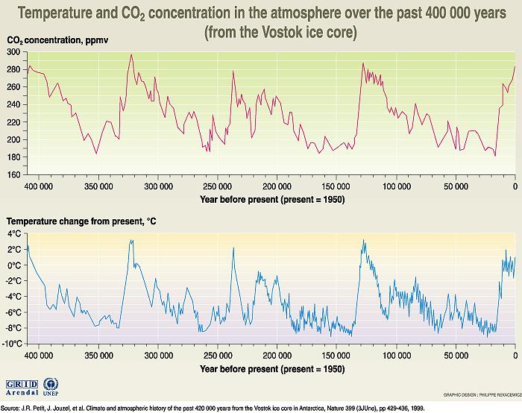

Slide 17
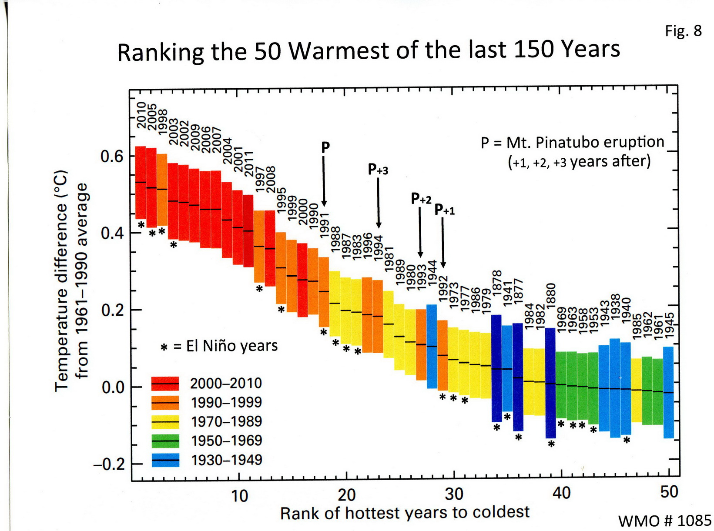

Slide 18
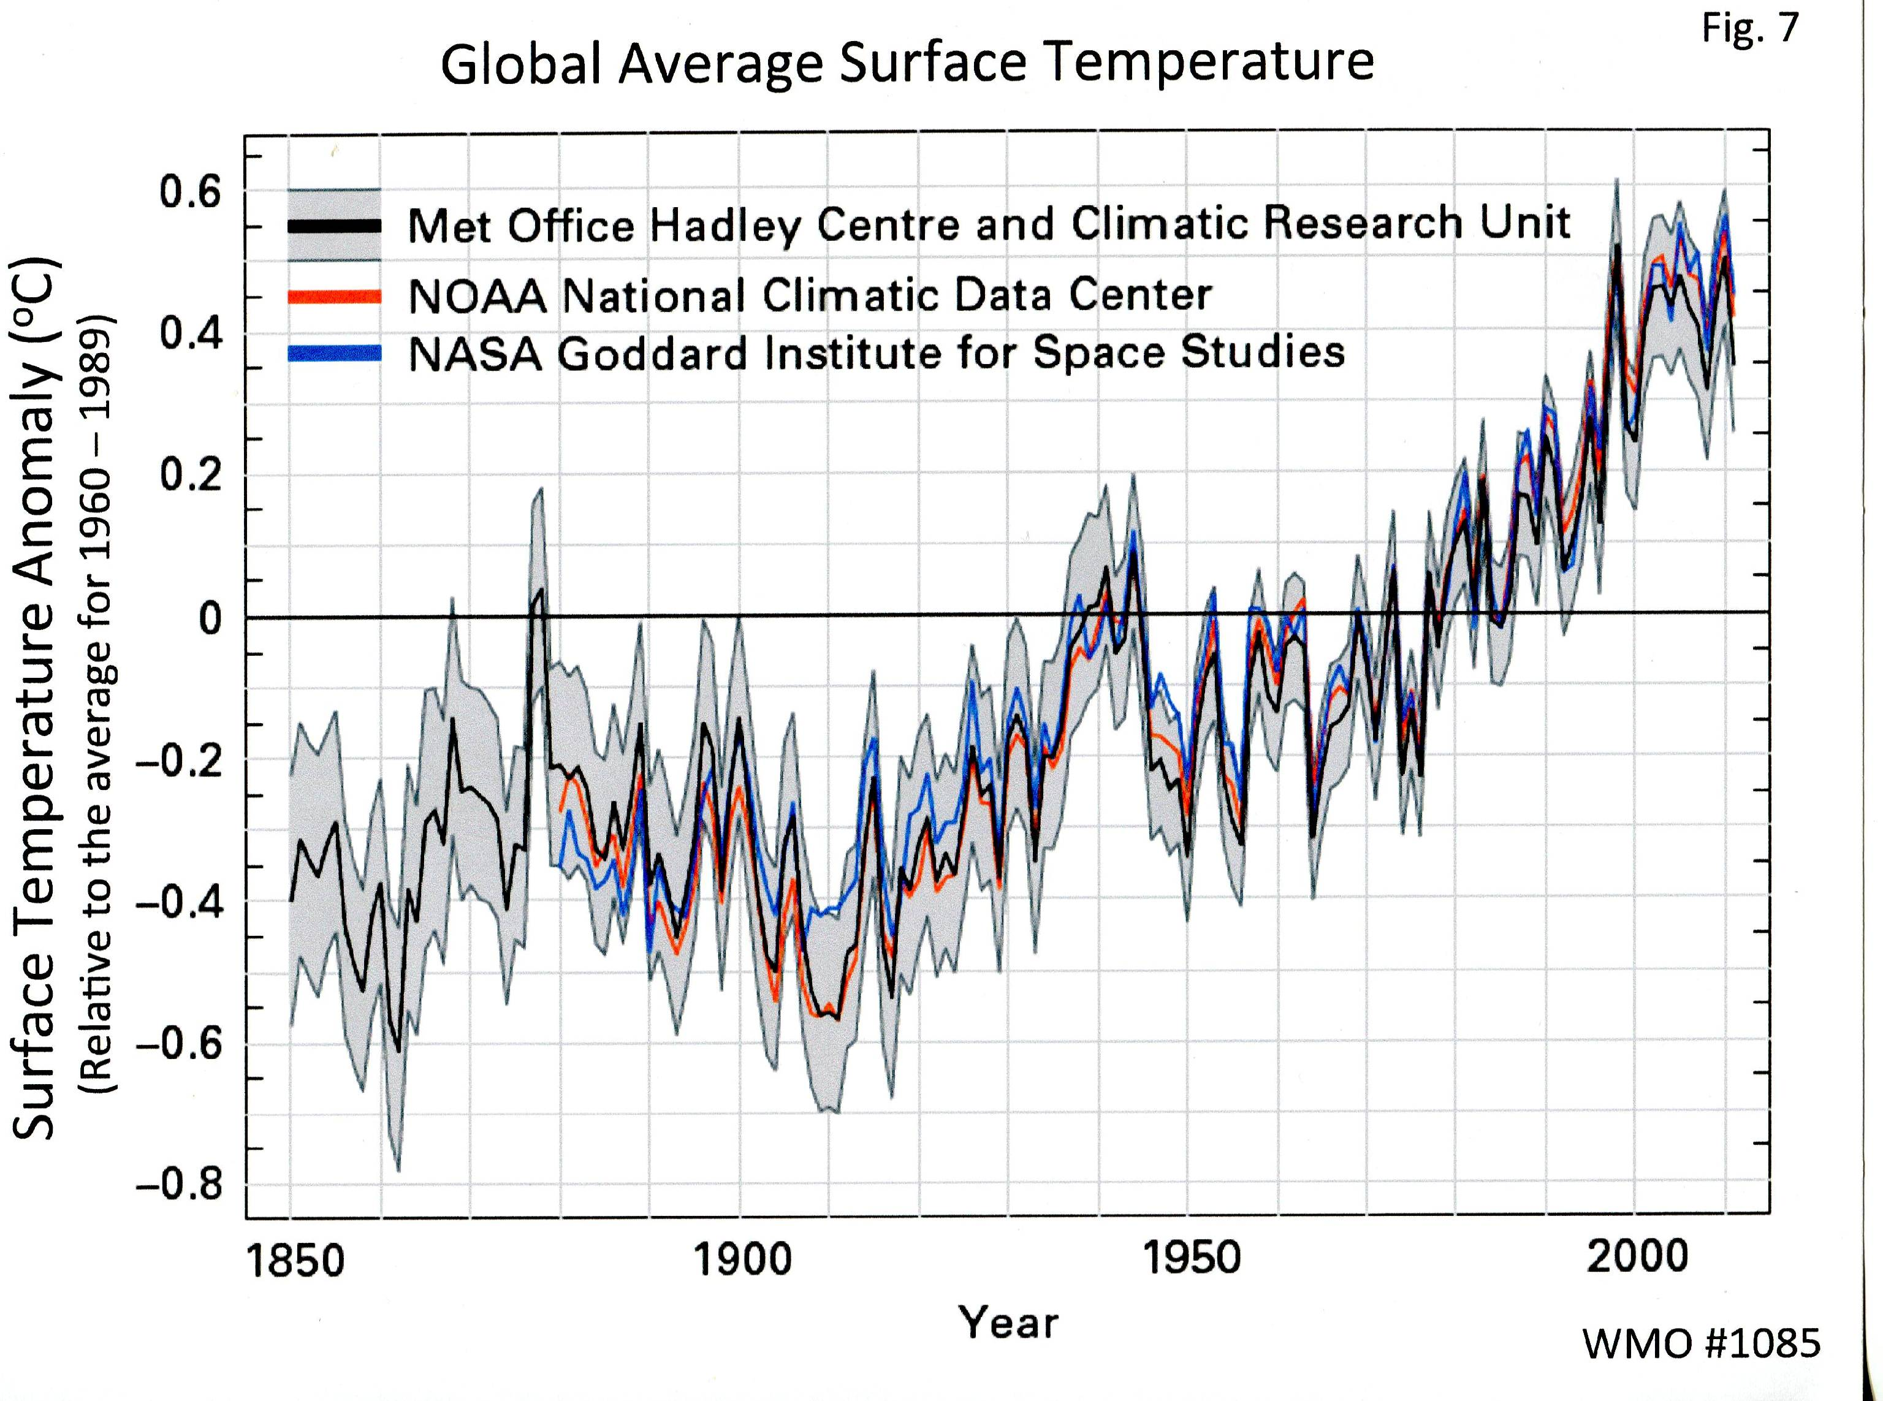

Slide 19
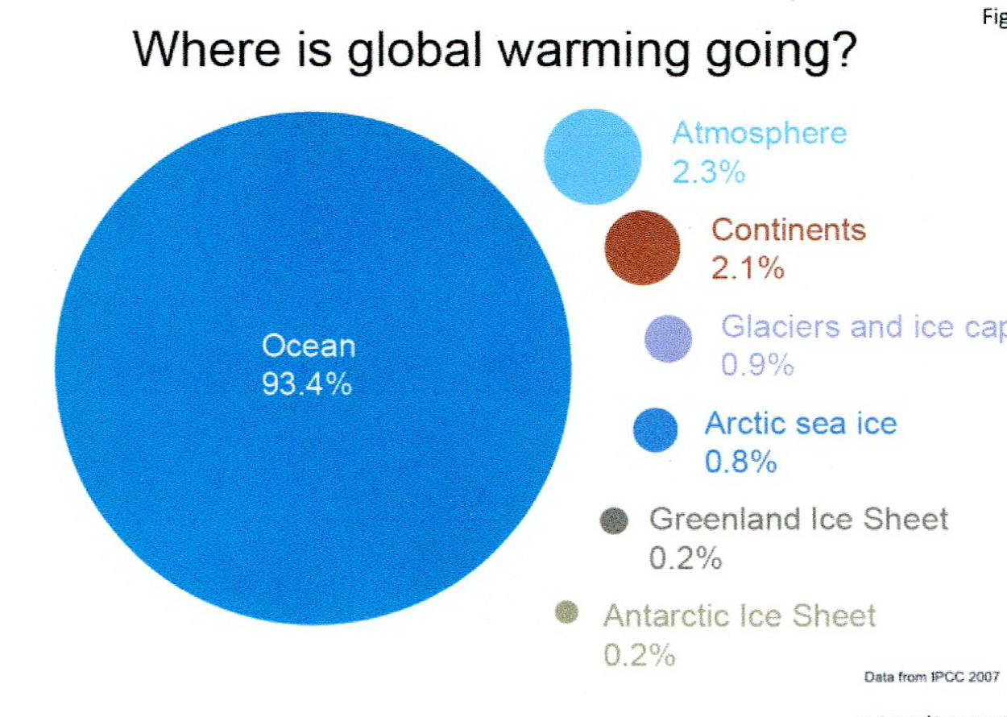

Slide 20
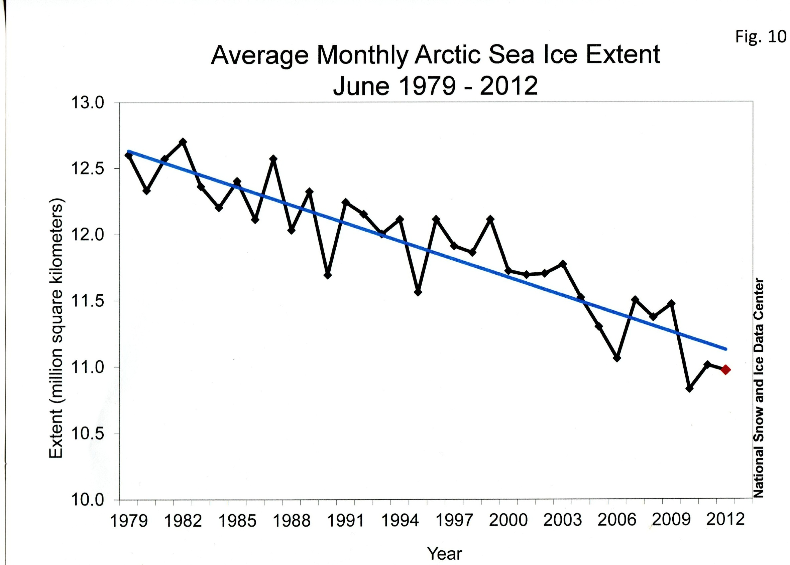

Slide 21
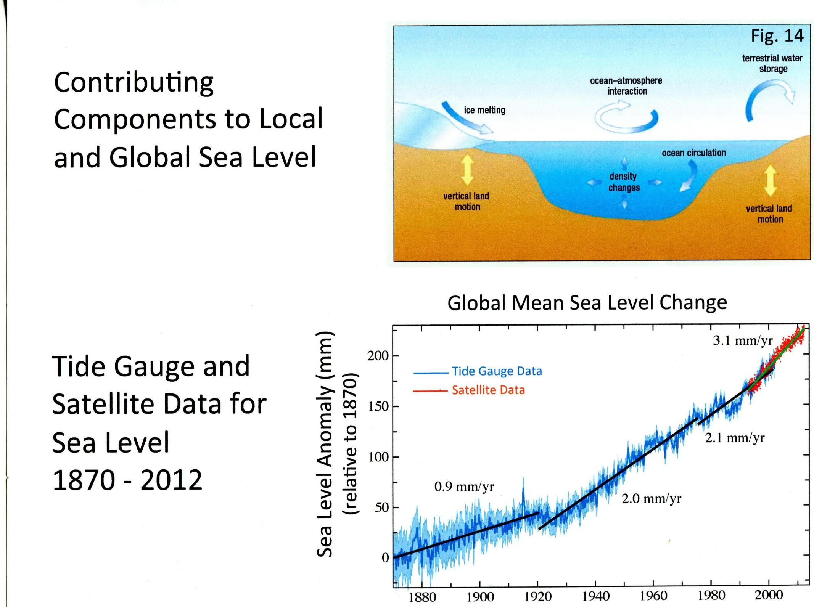

Slide 22
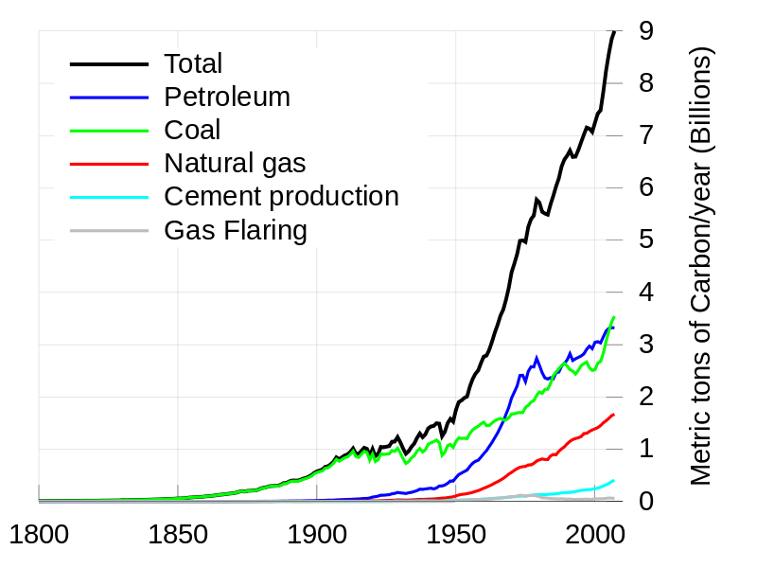
Sources of human activity sources of CO₂
Original Data citation: "Marland, G., T.A. Boden, and R. J. Andres. 2007. Global, Regional, and National CO2 Emissions
Original Data citation: "Marland, G., T.A. Boden, and R. J. Andres. 2007. Global, Regional, and National CO2 Emissions, from Wikipedia

Slide 23
Individual Companies’ Contributions to Total US Power Sector CO₂ Emissions
100 %
%
50 %
25 %

Slide 24
Why do many people reject the evidence that climate change is real and due, in large part, to human activities?
Is it fear from the message?
Distrust of the messenger?
Politics?
Ideology or culture?
Economic self-interest or
Something else?
Since 1934 the Tobacco Industry denied the health dangers of
smoking and millions of Americans died needlessly. What does
it take to restore fact-based policy making to our democracy?

Slide 25
Consequence of ignoring or denying science and health data: Tobacco
Surgeon General’s 1964 report: excessive smoking is causing a lung cancer epidemic.
Tobacco companies continued to win law suits with arguments about attribution, while knowingly conspiring to suppress and deny the scientific and medical evidence.
By 1998 Plaintiffs began to win suits when judges demanded release of documents showing evidence of tobacco company conspiracies.

Slide 26
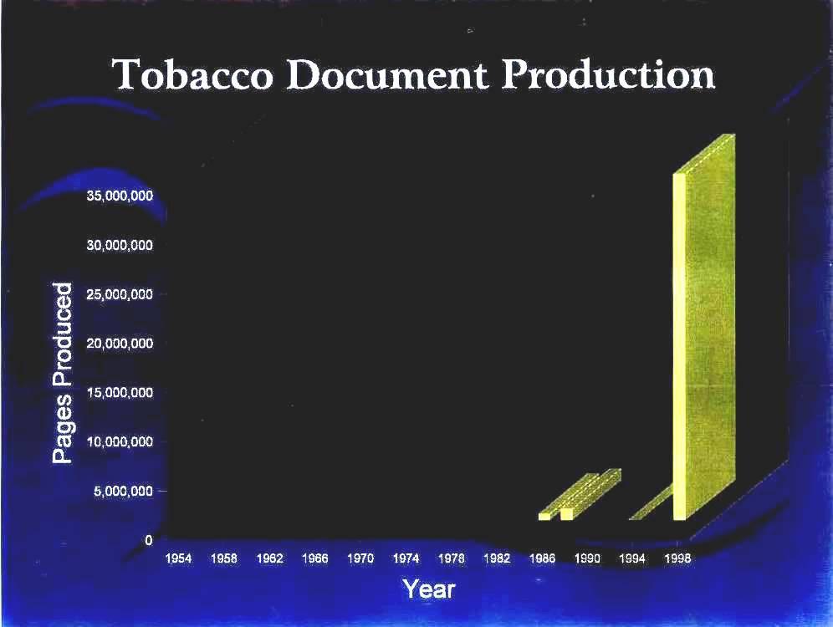
Notes:
80 million tobacco documents are searchable at UC San Francisco. Including 1953 Plaza Hotel meeting of Tobacco CEOs. They organized to support the Tea Party movement.

Slide 27
Denial of Strong Science – Protecting Financial & Political Interests
Misinformation and propaganda, masquerading as science and fueled by heavy spending, are injected not only into media accounts but into debates in the Congress.
Now the deniers want you to believe burning fossil fuels are not primary cause of global warming or dangerous climate change.

Slide 28
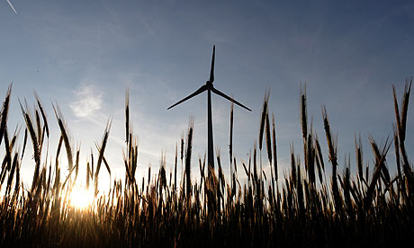
Confidential memo (seen by Guardian) calls for climate change skeptics to turn American public against wind power.
A number of right-wing organizations, including Americans for Prosperity, which is funded by the billionaire Koch brothers, are attacking Obama for his support for solar and wind power. The American Legislative Exchange Council (ALEC), which also has financial links to the Kochs, has drafted bills to overturn state laws promoting wind energy.

Slide 29
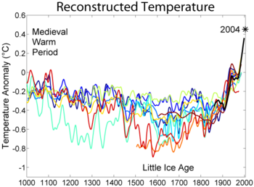
Northern Hemisphere temperatures for the last 600 or 1,000 years: by December 2005 more than a dozen reconstructions showed the basic finding that late 20th century temperatures significantly exceeded previous temperatures during that period.

Slide 30
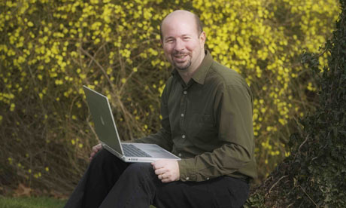
American climatologist Michael Mann, one of
the originators of the
graph of temperature
trends called the “hockey stick”.
photo: Jon Golden, Penn state
Michael Mann has successfully fought off an attempt by a
pro-industry think-tank to gain access to thousands of his
private emails. There is similar legal action against the
NASA scientist James Hansen. His research, demonstrating
a recent sharp rise in warming, is one of the most
easily understood representations of climate change
– and has also infuriated those opposing action on global
warming.

Slide 31
What Can Be Done to Reduce Global Warming and Climate Change?
New sources of renewable energy must be developed and adopted, globally.
Ultimately those who are responsible for oil, gas, and coal that cause global warming must be induced, by law or markets, to reduce their activities.
But public engagement must come first.
What can scientists do to convince the public to support public policies to slow climate change?

Slide 32
Seeking Rational Government Polices
The Union of Concerned Scientists has created a new Center for Science and Democracy, to help scientists to seek more rational public policies.
Issues like climate change will be discussed by forums of scientists, politicians, industry executives, social scientists, and the public seeking workable, long-term solutions.

Slide 33
Is The Enlightenment a Realistic Model?
Our nation’s founders were committed to unleashing the power of reason to advance knowledge and to build an effective, responsive and trust-worthy government.
The early voters were, like the founders, land-owning, white, men well-educated in the philosophy of the Enlightenment .

Slide 34
Do science and democracy rely on common principles?
Science offers a model that can help restore our government’s ability to make decisions through constructive debates and evidence-based decisions.
That’s because the progress of science is based on transparency, evidence, accountability, and trust.
These must also be the basic principles of a democratic government if it is to be legitimate, effective, credible and trusted by the electorate.

Slide 35
Why Many People Deny
Science and Reality
Chris Mooney argues that Motivated Reasoning is a physical property of the brain, when emotions are wired to take control of rational thinking.
“….Good arguments will only win the day when people don’t have strong emotional commitments that contradict them. “…Cold reasoning (rational, unemotional) is very different from hot reasoning (emotional, motivated).”
Research shows the more educated are even harder to dissuade from their illusions than the poorly educated.
The Enlightenment – the philosophy of the inevitable dominance of rationality -- is an illusion. Dan Yankelovich and other scholars of this issue would agree.
Chris Mooney, The Republican Mind, John Wiley, 2012.

Slide 36
Engaging the Public
An informed public is essential for democracy to work and is grounded in our political tradition.
Public is now confused and conflicted about climate change.
How to effect a transition from “raw opinion” to “considered, thoughtful judgment”?
Dan Yankelovich is the expert on this question.

Slide 37
Correcting Assumptions on Public Opinion on Technical Issues
On complex and emotion-laden issues, technical and economic facts are often secondary.
The message scientists transmit is not the message the public hears. The message is distorted by
  Inattention
  Lack of interest
  Denial
  Lack of context
  Bias from personal interests
  Science concepts are counter intuitive (eg. statistics)

Slide 38
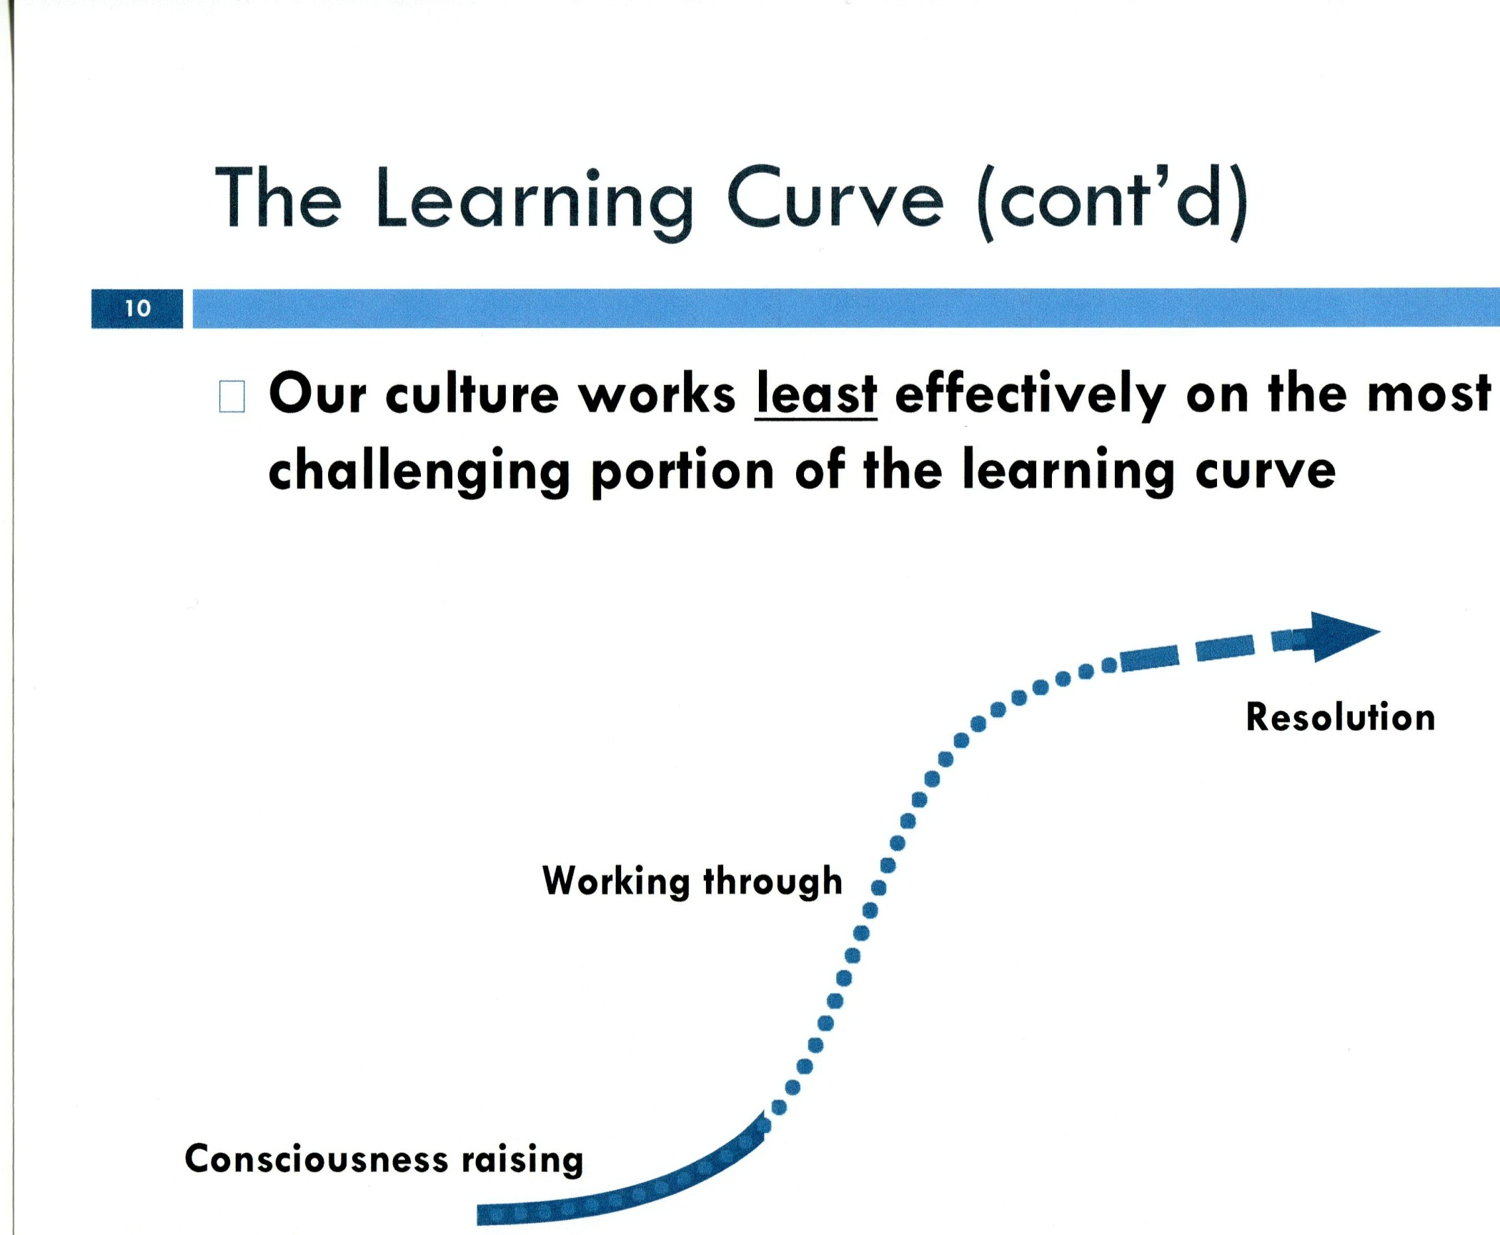

Slide 39
What Can Scientists Do to Promote Sound Rational Government and Public Policies?
Learn the lessons from 40 years fighting the Tobacco Industry.
Meet the challenge of climate change denial and other attacks on science and on rational government.
Expose non-profits who attack scientists & science illegally.
Understand and engage the public’s learning curve.
Improve public education and encourage youth to take home what they learn.
Engage the rational, responsible leaders in industry.
Support the Center for Science and Democracy in these tasks.

Slide 40
Further Reading
Lewis M. Branscomb, “Science, Politics and American Democracy,” Issues in Science and Technology, vol. 21, no. 1, Fall 2004, pp 53-59.
Lewis Branscomb and Andrew Rosenberg, The Scientist, Oct. 1, 2012
Chris Mooney, The Republican Mind, John Wiley, 2012.
James J. McCarthy, “Update on the role of the oceans in climate extremes and rising sea level,” Testimony to US Senate committee on Environment and Public Works, 1 August, 2012. http://www.ucsusa.org/assets/documents/global_warming/mccarthy-testimony-senate-08-01-12.pdf
Naome Oreskes and Eric Conway, Merchant of Doubt, New York Bloombury Press, 2010.
Seth Shulman, Undermining Science, Berkeley CA, University of Califoenia Berkeley, 2006.
Richard C. J. Somerville, Hearing on “Climate Science and EPA’s Greenhouse Gas Regulatins,” Committee on Energy and Commerce, subcommittee on Energy and Power, March 8, 2011. See http://democrats.energycommerce.house.gov/index.php?q=hearing/hearing-on-climate-science-and-epas-greenhouse-gas-regulations
David C. Victor, Global Warming Gridlock, New York, Cambridge U niversity Press, 2011.
Daniel Yankelovich and Will Friedman, Editors, Toward Wiser Public Judgment, Nashville, Vanderbilt University Press, 2010.

Slide 42
Truth and Lies
Truth is mighty and will prevail. There is nothing wrong with this, except that it ain't so. A lie can travel halfway around the world while the truth is putting on its shoes.
  Mark Twain (1835 – 1910)
No lesson seems to be so deeply inculcated by experience of life as that you should never trust experts. If you believe doctors, nothing is wholesome. If you believe theologists, nothing is innocent. If you believe soldiers, nothing is safe.
  Lord Salisbury, (Prime Minister of England 1885 – 1892, 1895 -- 1901)
Science, like any field of endeavor, relies on freedom of inquiry; and one of the hallmarks of that freedom is objectivity. Now, more than ever, on issues ranging from climate change to AIDS research to genetic engineering to food additives, government relies on the impartial perspective of science for guidance.
  George H. W. Bush (President of the USA, 1989 – 1993)

Slide 43
President Obama’s Commitment to Pragmatic & Fact-based Governance
A major emphasis during the 2008 campaign
OMB Directive to all Executive Departments and Agencies (May 18, 2012 by J. D. Zients, OMB Director):
  “Since taking office, the President has emphasized the need to use evidence and rigorous evaluation in budget, management and policy decisions to make government work effectively.…Where evidence is strong, we should act on it. Where evidence is suggestive, we should consider it. When evidence is weak, we should build the knowledge to support better decisions in the future.”

